Slide 1
Steps to Embed Fonts in Power Point

Slide 2

Select File

Slide 3
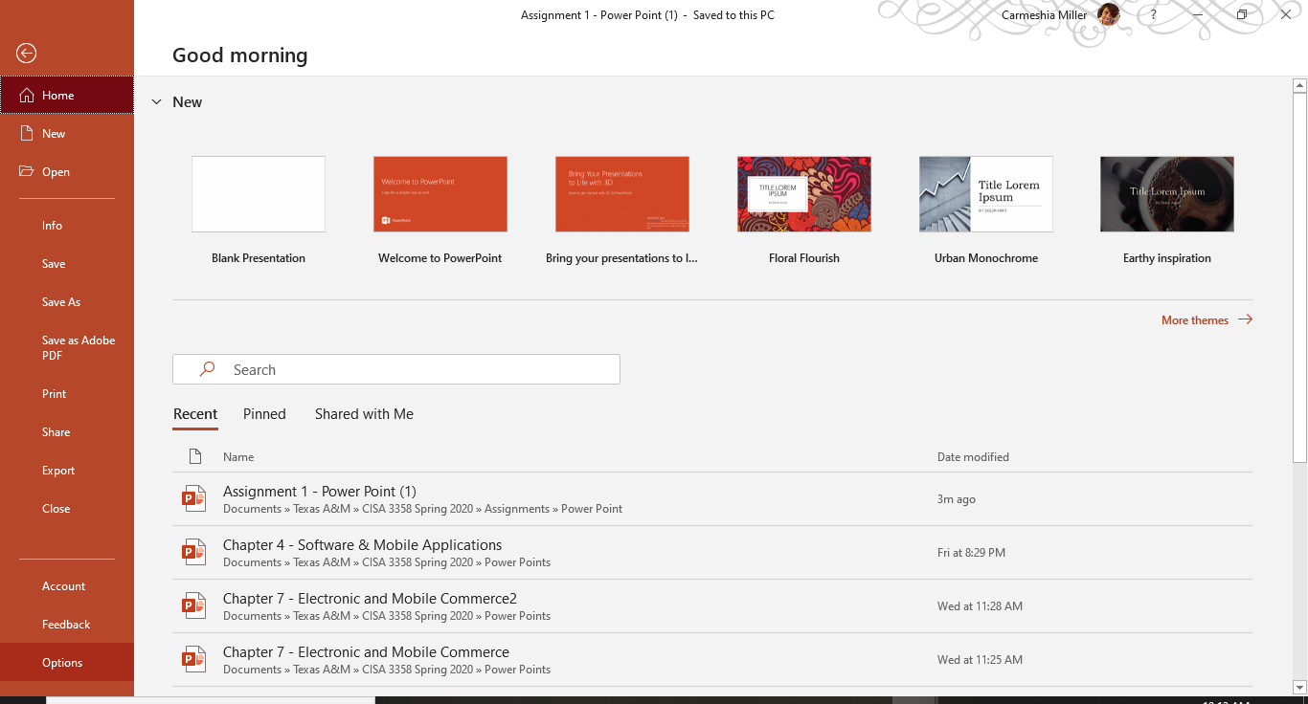
Select Options

Slide 4
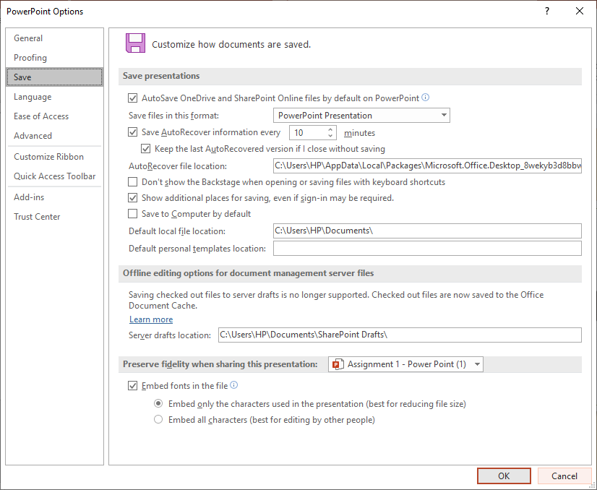
Select Save

